Slide 1
Data analysis & visualization Project
Meron Bekure
DATA 211 – Data Science and Visualization

Slide 2
topic
Social Media usage over a two-week period
Is my daily average social media usage greater than 60 mins? Use a 0.05 significance level to test the claim that my mean daily social media usage is greater than 60 mins.

Slide 3

Data collection
I phone
Screen time

Slide 4
Most used Social Media Types

Slide 5
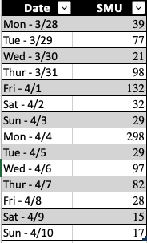

Tables

Slide 6
NULL and alternative Hypothesis
H0: mu = 60
Ha: mu > 60
Other areas to analyze:
Is my weekend usage > weekday usage

Slide 7
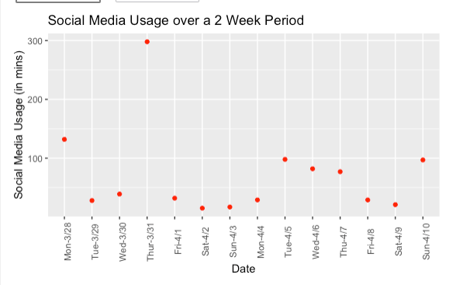
Visualizations

Slide 8

t.tEST
t.test(Project_Analysis_Table$SMU, mu=60, alternative = "greater")
t.stat =0.55 p.value=0.30
We fail to reject the H0. There's no evidence to support the claim that my daily social media usage is greater than 60 mins.

Slide 9
Further Analysis
Is my weekend usage > weekday usage
Using the mutate function, I was able to separate the weekend and weekday to look at how the daily average usage compares between weekday and weekend...

Slide 10
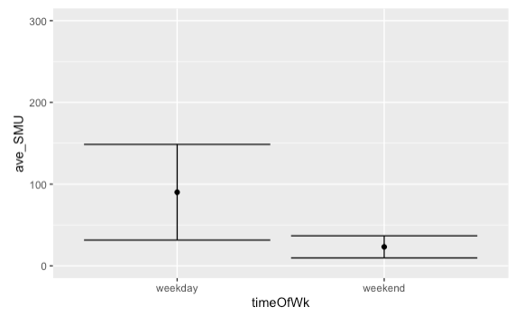
Weekend vs weekday Results...

Slide 11
retrospective
Longer data collection period
Identifying different variables that may affect my results

Slide 12
Next steps
Increasing awareness about the factors that may contribute to my increased social media usage.
Making improved decisions to make better use of my time

Slide 13
Thank you for your time!

